Slide 1
One Seed to Find Them All: Mining Opinion Features via Association
Author : Zhen Hai, Kuiyu Chang, Gao Cong
Source : CIKM’12
Speaker : Wei Chang
Advisor : Prof. Jia-Ling Koh

Slide 2
Outline
Introduction
Approach
Experiments
Conclusion

Slide 3
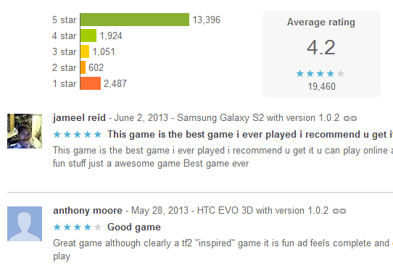
Opioion

Slide 4
Can computers understanding opinions ?

Slide 5
Explicit And Implicit Feature
“The exterior is very beautiful, also not expensive, though the battery is not durable, I still unequivocally recommend this cellphone!”
Explicit
exterior, battery, cellphone
Implicit
price

Slide 6
Previous Work
Supervised learning
Need a lot of training data
Domain dependency
Unsupervised learning
NLP syntactic parsing
Informal writing

Slide 7
Goal
Proposed a framework to identify opinion features.
Advantages :
More robust (compared to syntactic parsing)
Good performance with only on word in the seed set

Slide 8
Outline
Introduction
Approach
Experiments
Conclusion

Slide 9
Bootstrapping Algorithm
Find candidate features and opinions
Generate association model
Bootstrap algorithm

Slide 10
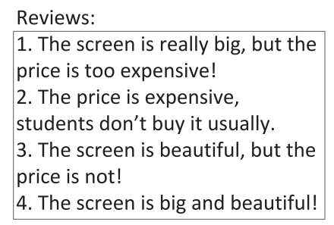
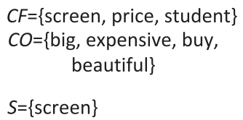
Find Candidate Features And Opinions
(manually)
CF(Candidate Features) : nouns, noun phrase with subject-verb, verb-object, preposition-object
CO(Candidate Opinion) : adjectives and verbs

Slide 11
Bootstrapping Algorithm
Find candidate features and opinions
Generate association model
Latent Semantic Analysis
Likelihood Ratio Test
Bootstrap algorithm

Slide 12
Generate Association Model

Slide 13
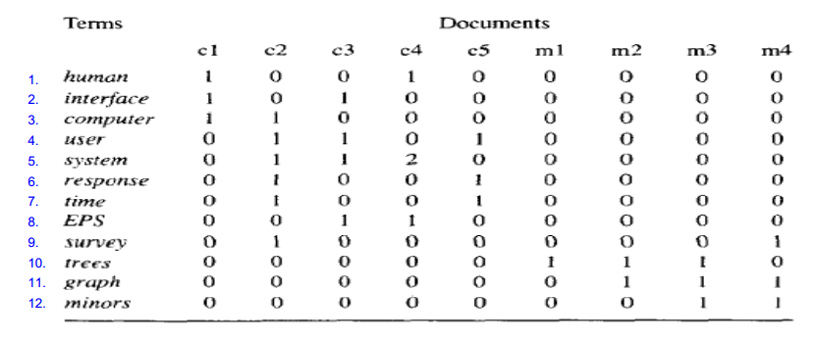
Latent Semantic Analysis (1)

Slide 14
Latent Semantic Analysis (2)

Slide 15
Latent Semantic Analysis (3)

Slide 16
Bootstrapping Algorithm
Find candidate features and opinions
Generate association model
Latent Semantic Analysis
Likelihood Ratio Test
Bootstrap algorithm

Slide 17
Likelihood Ratio Tests

Slide 18
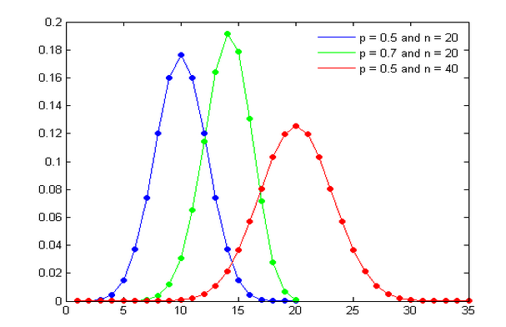
Binomial Distribution

Slide 19
Likelihood Ration

Slide 20
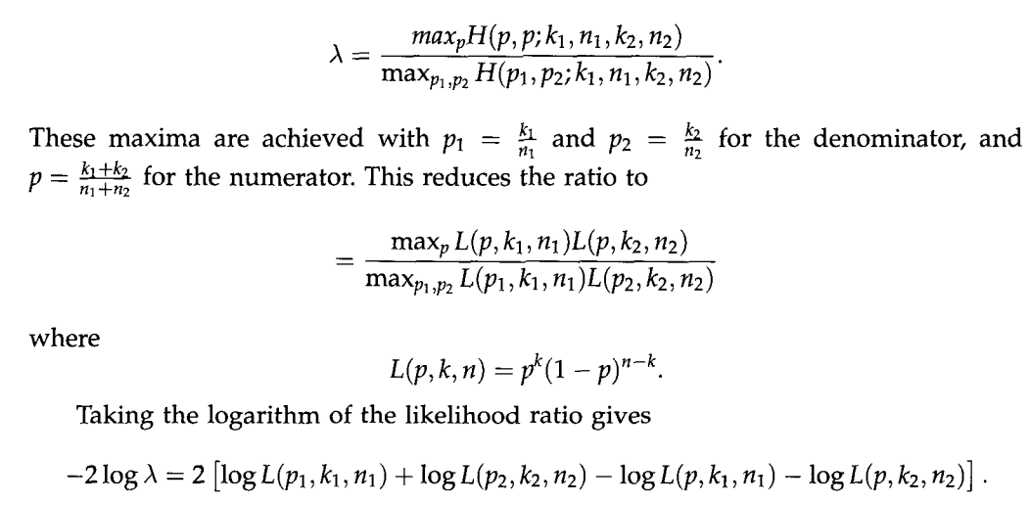
The Comparison Of Two Binomial

Slide 21
Bootstrapping Algorithm
Find candidate features and opinions
Generate association model
Bootstrapping algorithm

Slide 22
We Already Have

Slide 23
Algorithm
Identified feature
Identified opinion
F
O
CF
CO
screen
price
big
student
expensive
buy
beautiful

Slide 24
Algorithm

Slide 25
Outline
Introduction
Approach
Experiments
Conclusion

Slide 26
Dataset
Hotel : www.lvping.com/hotels
Cellphone : product.tech.163.com
Tool : http://ir.hit.edu.cn/demo/ltp/

Slide 27
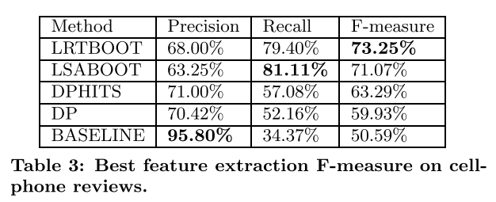
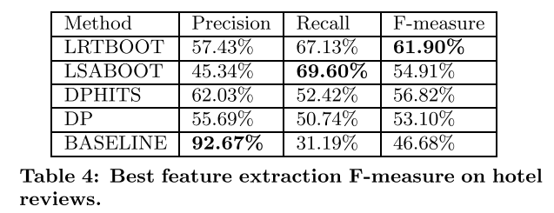
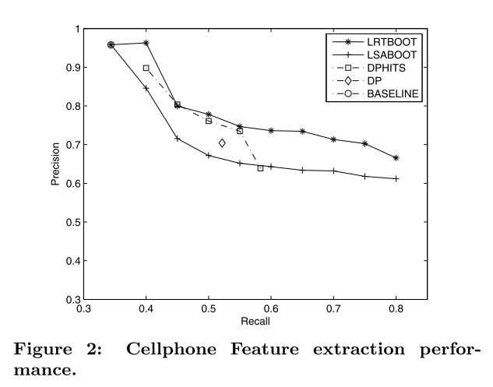
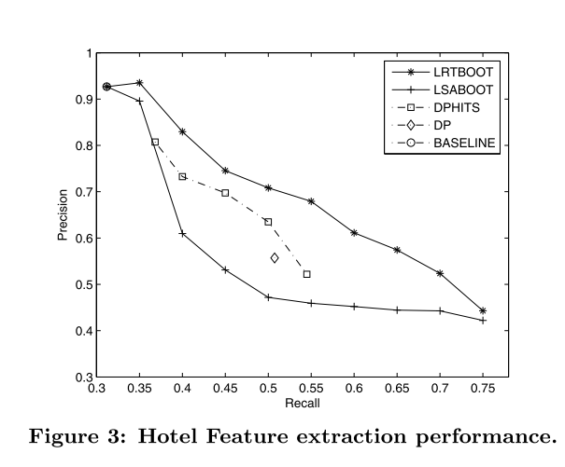
High F-measure

Slide 28
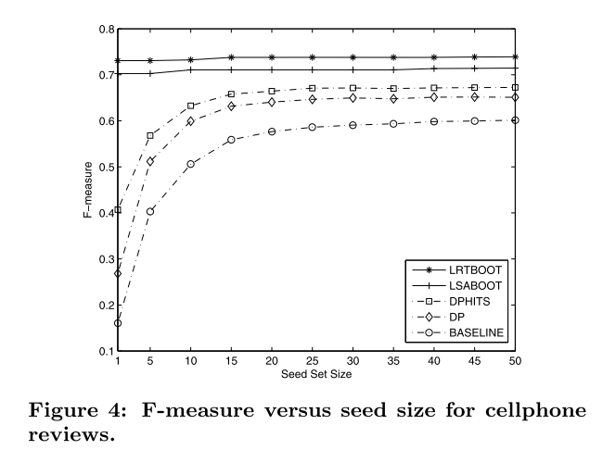
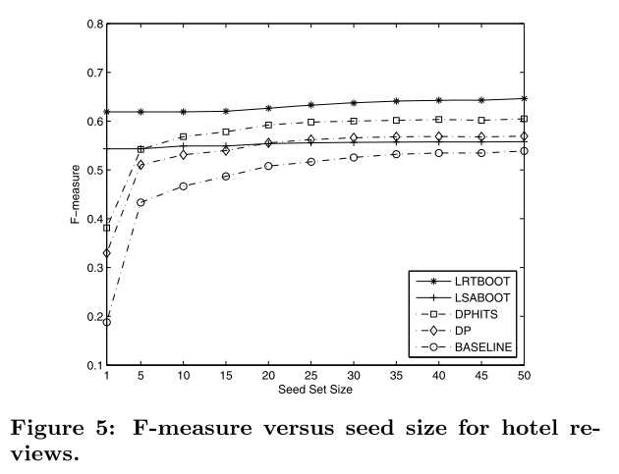
One Seed is Enough

Slide 29
Outline
Introduction
Approach
Experiments
Conclusion

Slide 30
Conclusion
Proposed an effective approach for opinion feature extraction
Achieve good performance at one seed word
Disadvantage :
Infrequent features
Non-noun features
Errors in POS tagging

